Slide 1


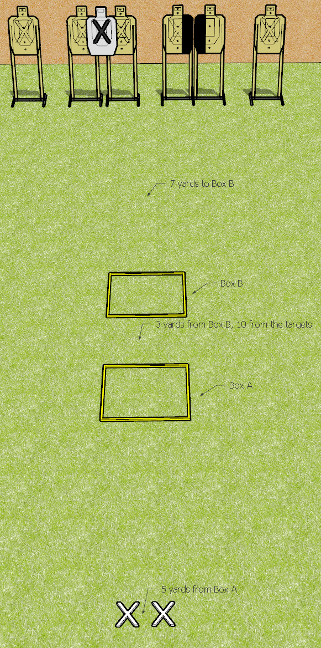
 | Dothan Gun Club – USPSA Match Foley Wants His Classifier Back Course Designer : Drew Coleman
START POSITION : String 1: Standing both feet on X’s. String 2: Standing anywhere in Box A
GUN READY CONDITION : Pistol loaded and holstered. PCC shouldered, safety on, pointed at start box |  | SCORING: Virginia Count, 24 rounds TARGETS: 6 paper, 0 Steel SCORED HITS: Best 4 on paper START-STOP: Audible, last shot RULES: Targets are designated from left to right as T1-T6. Failure to switch to shoot strong/weak hand only after the reload will be a procedural per shot fired.
STAGE PROCEDURE: String 1: Move to shooting box A and engage T1-3 with 2 rounds each freestyle then make a mandatory reload and engage T4-6 with two rounds each strong hand only String 2: Move to shooting box B and engage T1-3 with 2 rounds each freestyle then make a mandatory reload and engage T4-6 with two rounds each weak hand only

